Slide 1

A PROJECT-II FINAL DEFENSE ON THE FASHION GALLERY
Project Members
Asha Silwal(TU Regd. No : 6-2-253-2-2019)
Puja Thapa(TU Regd. No : 6-2-253-8-2019)
Submitted To:
Department of Computer Application
2080-08-11

Slide 2
INTRODUCTION
“The Fashion Gallery” is web-based application
Provide SQL-based solution to store products
Develop project under incremental model
Variety of items for different gender
Payment Integration
Easy search and recommendations of related products

Slide 3
PROBLEM STATEMENT
Traditional way is less efficient
Customers need to visit physically
Limited customer reach
Difficult to manage products
Costly i.e. rent, staffing etc.
Consumers changing preferences

Slide 4
OBJECTIVES
To offer diverse range of fashion products
To offer linear search and recommendation on content- based
To offer online payment method
To provide better customer services

Slide 5
SCOPE
Global Access : Access to diverse fashion products globally.
Global Showcase : Platform for designers, manufacturers, and retailers to sell products.
Advanced Technology : Enhances shopping with advanced technology for easy discovery and recommendations.
Quality Focus : Focus on quality, trust, and customers’ satisfaction.

Slide 6
LIMITATION
Global shipping constraints
Inconvenient in returns and refunds
May not compatible with all types of digital devices

Slide 7
FEASIBILITY STUDY
ECONOMIC FEASIBILITY
no other expenses are required
technologies are freely available
OPERATIONAL FEASIBILITY
- no need of extra effort for user
- make user familiar to this system
- user friendly; easily access to data
TECHNICAL FEASIBILITY
limited demand on available technologies
minimal or null changes are required

Slide 8
SYSTEM REQUIREMENT
HARDWARE
Laptop/Computer having
Processor intel P4 or latest
Around 512 MB RAM
Upto Hard disk of 250 MB
SOFTWARE
Windows Operating System
Xampp
Toolkit: Visual Studio Code
Coding Language: PHP, HTML, CSS, JavaScript

Slide 9
LITERATURE REVIEW
Study conducted by Kim and Kim (2017) [3]
- essential to focus on customer satisfaction
Study by Soni and Vashishtha (2020) [4]
quality is a factor in customer satisfaction
Study by Pazzani and Billsus (2007) [5]
- Content-based filtering recommends items by analyzing their features and matching them with user preferences

Slide 10
LITERATURE REVIEW
Study by A. R. Mohanty et al. [6]
linear search was effective in identifying and extracting important features from images
Study by MetaPack (2020) [7]
delivery methods are in line with industry standards
Study by Sharma et al. (2021) [8]
- mobile payment integration enhances customer experience

Slide 11
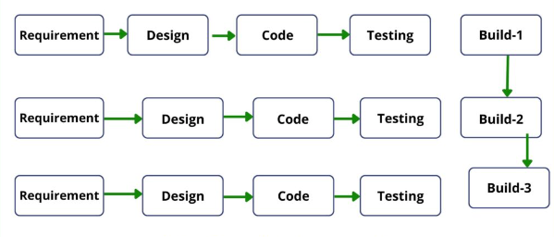
METHODOLOGY
Requirements
i. Functional Requirements
home page(login form)
registration Page
product lists page
shopping cart page
ii. Non-Functional Requirements
fast and accurate
user friendly environment
effective and efficient performance
First Increment :
- Planning and development of interfaces
Second Increment :
- Insertion and management of products
- Connection of database
Third Increment :
- Integrating system, final testing and maintaining
Figure 1 : Incremental Model [9]

Slide 12
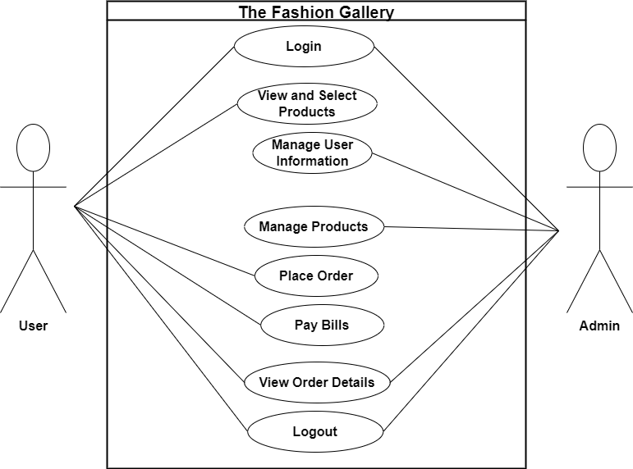
METHODOLOGY
Figure 4: Use Case Diagram Of The Fashion Gallery

Slide 13
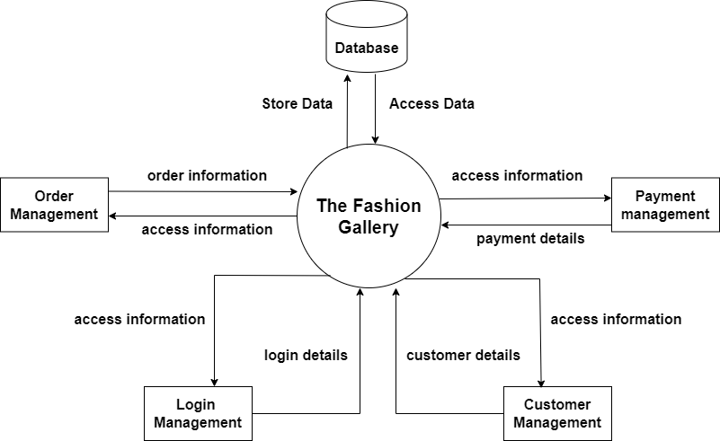
METHODOLOGY
Figure 5 : Block Diagram Of The Fashion Gallery

Slide 14
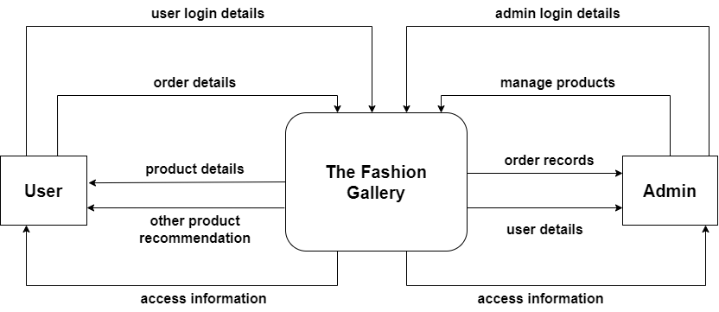
METHODOLOGY
Figure 5 : Zero Level DFD Of The Fashion Gallery

Slide 15
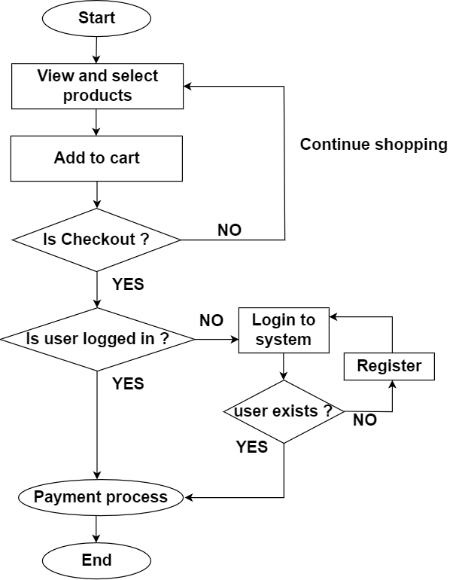
METHODOLOGY
Figure 6: System Flowchart Of The Fashion Gallery

Slide 16
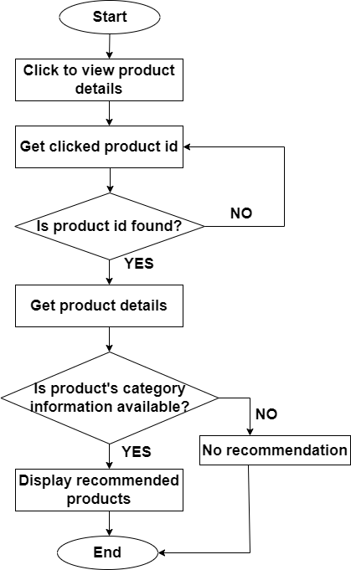
METHODOLOGY
Figure 7: Flowchart Of Content-based Filtering On The Fashion Gallery

Slide 17
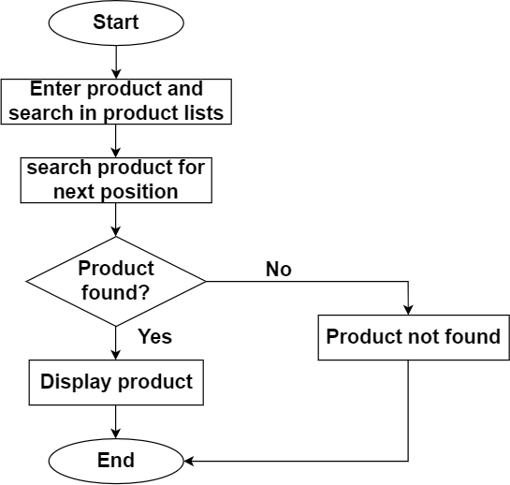
METHODOLOGY
Figure 8: Flowchart Of Linear Search On The Fashion Gallery

Slide 18
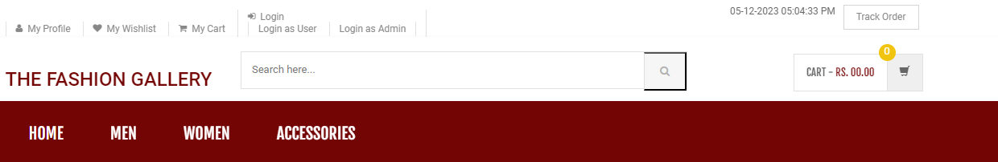
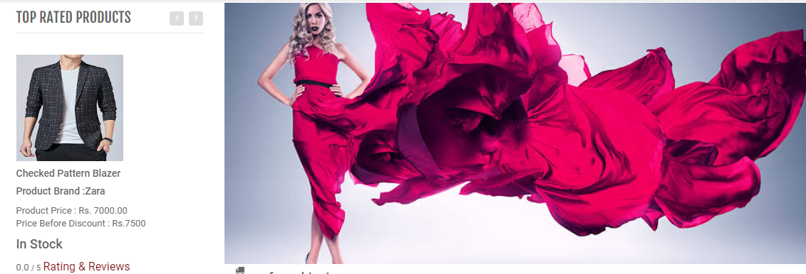
INTERFACE DESIGN
User Page

Slide 19
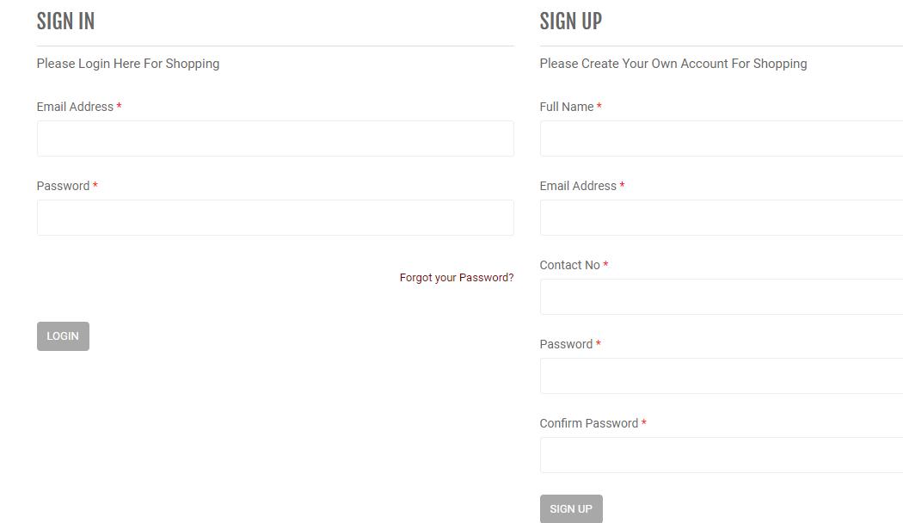
INTERFACE DESIGN
User Page

Slide 20
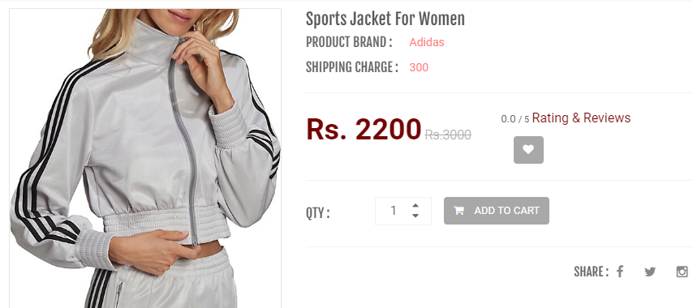
INTERFACE DESIGN

Slide 21
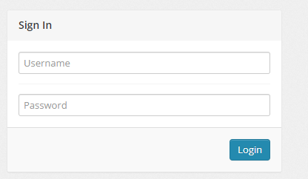
INTERFACE DESIGN
Admin Page

Slide 22
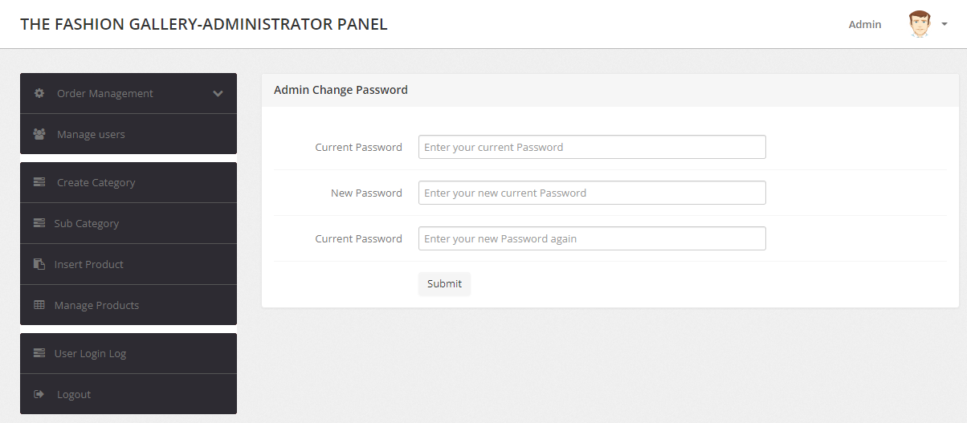
INTERFACE DESIGN
Admin Page

Slide 23
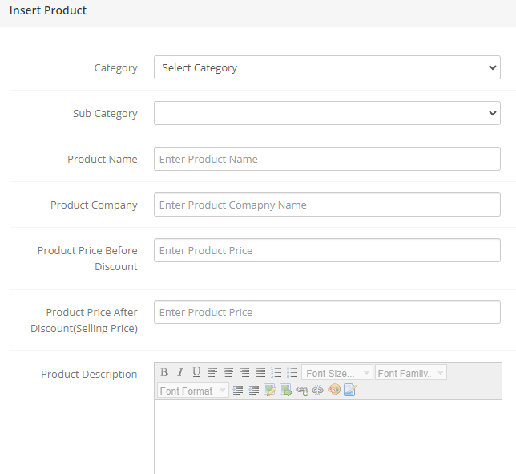
INTERFACE DESIGN
Admin Page

Slide 24
IMPLEMENTATION AND TESTING
Implemented Modules
User Module : Manages user accounts and access to the system.
Product Catalogue Module : Organizes and displays a variety of clothing items and accessories.
Shopping Cart Module : Facilitates the selection and accumulation of desired items for purchase.
Search Functionality Module : Enables users to find specific products quickly.
Collaborative Filtering Module : Recommends items based on user preferences and history.
Payment Integration Module : Handles secure online transactions.
Customer Review Module : Allows users to share feedback on products and services.
Inventory Management Module : Organizes and tracks a large number of products.

Slide 25
IMPLEMENTATION AND TESTING
Unit Testing for Admin Module
Unit Testing for User Module
S.N | Test Case | Expected Output | Remarks
1 | Sign In with valid username and password | Login successfully !! Redirect admin to admin’s index page | Test successful
2 | Sign In with invalid username or password | Login failed !! Alert message for valid input insertion | Test successful
S.N | Test Case | Expected Output | Remarks
1 | Sign In with valid email and password | Login successfully !! Redirect user to index page | Test successful
2 | Sign In with invalid email or password | Login failed !! Alert message for valid input insertion | Test successful

Slide 26
IMPLEMENTATION AND TESTING
System Testing for Admin Module
S.N | Test Case | Description | Expected Output | Remarks
1. | Sign In | Enter valid login details for admin | Redirect to admin’s index page | Test successful
2. | Product Insertion | Fill all the fields in insertion with product details | Insertion successful !! Product should be inserted to database | Test successful
3. | Product Update | Enter details that should be changed | Changed successful Changes should be saved to database | Test successful
4. | Product Search | Enter letters or name | Products that matched search letter or name should be displayed to screen | Test successful
5. | Product Delete | Click cross sign to delete product | Product should be deleted from database | Test successful
7. | Product Category Create and Update | Create category of product and change category according to need | Product category should be inserted in database and update changes | Test successful
8. | Product Subcategory Create and Update | Choose category and name subcategory of product and change subcategory according to need | Product subcategory should be inserted in database and update changes | Test successful
9. | View User Lists | Select manage users | All user lists should be viewed to admin | Test successful
10. | View Order Lists | Select order management | All order lists should be viewed to admin | Test successful

Slide 27
IMPLEMENTATION AND TESTING
System Testing for User Module
S.N. | Test Case | Description | Expected Outcome | Remarks
1. | Sign In | Enter valid email and password | Login Successful !!! Redirect to index page | Test successful
2. | Categories list | Choose any category listed | Product lists should be displayed on the basis of category | Test successful
3. | My Wishlist | Show wish lists only if login to system | All wish list should be displayed | Test successful
4. | My Profile | Show the details of user | All details of user should be displayed | Test successful
5. | Track Order | Track the order by giving order id and email | Redirect to track-order page | Test successful
6. | Add to cart | Add products to cart for purchasing | If login to system then goes for checkout else redirect to login page | Test successful
7. | Checkout | Pay bill | Redirect to payment method for purchasing | Test successful
8. | Your Order History | Display all the order history of user | All the order history should be displayed | Test successful

Slide 28
CONCLUSION AND FUTURE RECOMMENDATION
Goals Achieved :
Modernization : Modernized traditional shopping through an online platform.
Variety : Showcases a wide range of fashionable clothing items and accessories for various genders.
Convenience : Addresses challenges of traditional shopping with search functionalities.
Personalization : Implements a collaborative filtering for recommendation based on customer history for product suggestions.

Slide 29
CONCLUSION AND FUTURE RECOMMENDATION
Goals Achieved :
Trust and Satisfaction : Focuses on customer satisfaction and trust through reliable payment integration and delivery methods.
Accessibility : Enables customers to shop from anywhere using devices, eliminating the need to visit physical stores.
Quality Assurance : Emphasizes on providing quality products and services to gain customer trust.
Organized Management : Well-organized management of a large product inventory.

Slide 30
CONCLUSION AND FUTURE RECOMMENDATION
Future Enhancement :
Enhanced More Features
Mobile App Development
Integration with Social Media
Expand Product Range
Enhanced Security Measures

Slide 31
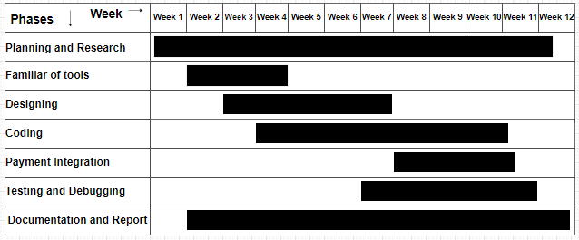
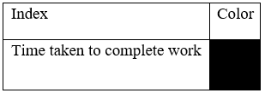
WORK SCHEDULE
Gantt Chart

Slide 32
REFERENCES
S Singh, Saud Ramesh, Chaudhary Indra. DATABASE MANAGEMENT SYSTEM. KEC Publication and Distribution Pvt. Ltd, 2076.
Singh, Saud Ramesh, Singh Saud Bhupendra, Chaudhary Indra. SYSTEM ANALYSIS AND DESIGN. KEC Publication and Distribution Pvt. Ltd, 2076.
Kim, H. J., & Kim, Y. K. "Customer satisfaction and loyalty in the fast fashion business." Journal of Fashion Marketing and Management, vol. 21, no. 3, 2017, pp. 340-353.
Soni, S., & Vashishtha, P. "Factors affecting customer satisfaction in the Indian apparel retail industry: An empirical study." Journal of Fashion Marketing and Management, vol. 24, no. 1, 2020, pp. 74-91.
Pazzani, M. J., & Billsus, D. (2007). Content-Based Recommendation Systems. In The Adaptive Web (pp. 325-341). Springer.
Mohanty, A. R., Rath, S. K., & Baliarsingh, A. K. "Feature Extraction Using Linear Search Algorithm for Image Classification." Journal of Multimedia, vol. 6, no. 4, 2011, pp. 423-430.
MetaPack. "The 2020 state of e-commerce delivery." 2020.
Sharma, S., Singh, M. S., & Dwivedi, Y. K. "Analysis of Consumer Adoption of Artificial Intelligence in Service Encounters." Journal of Service Research, vol. 24, no. 1, 2021, pp. 23-40.
https://sampletestcases.com/incremental-model/

Slide 33
THANK YOU

